Slide 1
Smart Traffic Management Using Deep Learning
Pranav Bhanot 20BAI1087
Karthik Raj 20BCE1420
Avneesh Kasture 20BCE1438
Shivam Sharma 20BCE1442
Manvik Sreedath 20BCE1479

Slide 2
Introduction
Traffic management is a critical aspect of modern transportation systems that aim to provide safe, efficient, and sustainable mobility to people and goods. With the increasing complexity and volume of traffic, traditional traffic management approaches that rely on human expertise and rule-based systems are becoming less effective.
However, recent advancements in artificial intelligence, particularly deep learning, offer a promising solution to tackle this challenge. Deep learning is a subset of machine learning that uses neural networks with multiple layers to learn complex patterns and relationships in data. In the context of traffic management, deep learning algorithms can be trained on large datasets of traffic data, including video footage, sensor data, and vehicle trajectories, to learn the underlying patterns and predict future traffic conditions.

Slide 3
Deep learning algorithms have shown great potential in improving traffic management by providing more accurate and timely predictions of traffic conditions. By analyzing large volumes of traffic data, deep learning models can identify traffic patterns, predict traffic congestion, and provide real-time traffic updates to drivers and transportation authorities. This can help reduce travel times, lower emissions, and improve safety on the road.
Moreover, deep learning models can be used for traffic signal optimization, where traffic signals are dynamically adjusted based on real-time traffic conditions to minimize delays and congestion. These models can also be applied to autonomous vehicles, allowing them to navigate traffic more efficiently and safely.

Slide 4
Despite its many benefits, the implementation of deep learning in traffic management comes with some challenges, such as the need for large amounts of data, high computational requirements, and potential privacy concerns. Addressing these challenges will be critical to ensure the widespread adoption of deep learning in transportation systems.
Overall, the application of deep learning in traffic management has the potential to revolutionize the way we manage traffic, improve road safety, and create more sustainable transportation systems.

Slide 5
Materials used
Rpi
Rpi camera
LEDs
Resistors
Jumper Wires

Slide 6
Raspberry Pi
Raspberry Pi is a small, low-cost, credit-card-sized computer that was first released in 2012. Developed by the Raspberry Pi Foundation, the device was designed to promote the teaching of basic computer science in schools and developing countries. The Raspberry Pi has since become popular among hobbyists and tinkerers for its versatility and affordability. It runs on a version of Linux and can be used for a wide range of applications, from basic computing tasks to home automation, robotics, and even media centers. Its small form factor and low power consumption make it ideal for embedded systems and Internet of Things (IoT) projects. Overall, the Raspberry Pi has become a popular tool for learning and innovation in the world of technology.

Slide 7
Model used
The training process generates a set of weak classifiers that can detect specific features of the vehicle, such as edges, corners, and textures. These weak classifiers are combined into a strong classifier by a cascade of classifiers, where each stage progressively filters out false positive detections while keeping the true positive detections.
During the detection process, the image is analyzed at multiple scales and locations to identify potential vehicle regions using a sliding window approach. The cascade classifier is then applied to each window to determine whether it contains a vehicle or not. This process is highly efficient since regions that are unlikely to contain vehicles are quickly rejected in the early stages of the cascade, reducing the overall computational complexity.

Slide 8
Overall, the vehicle detection model has many practical applications, such as traffic management, surveillance, and autonomous driving. As technology continues to advance, the accuracy and efficiency of this model are expected to improve, making it an even more valuable tool for transportation systems.
In addition to detecting vehicles, this model can also be extended to identify other objects and features on the road, such as traffic signs, pedestrians, and road markings. This can help improve the overall safety of the road and reduce the likelihood of accidents.

Slide 9
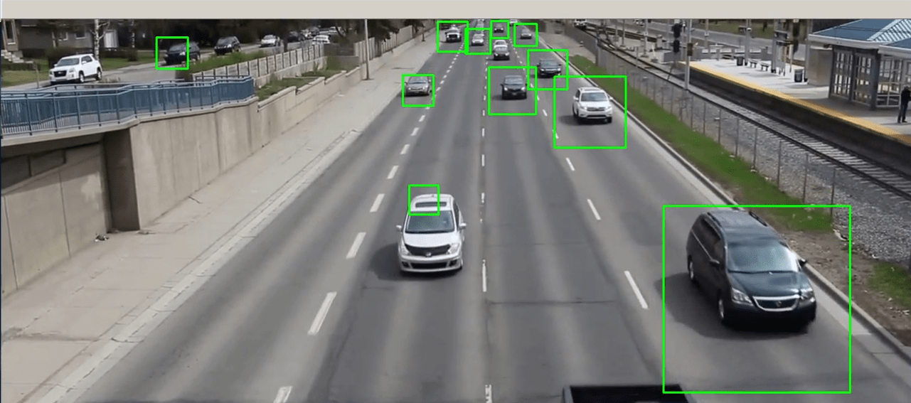
Implementation
Two cameras record videos of two roads at a junction.
At an instance of the video an image is taken.
The model uses this image to give us an approximate number of cars on each road at the junction.
Using these numbers, we will let the roads which are more populated get a green light to move forward while keeping a count of the number of times each road has been given a green light.

Slide 10
Results
The algorithm is run on the rpi and is able to successfully detect objects/cars at an accuracy of 84%.
Traffic was efficiently managed at the traffic junction

Slide 11
Thank You

